Slide 1
constants

Slide 2
comments

Slide 3
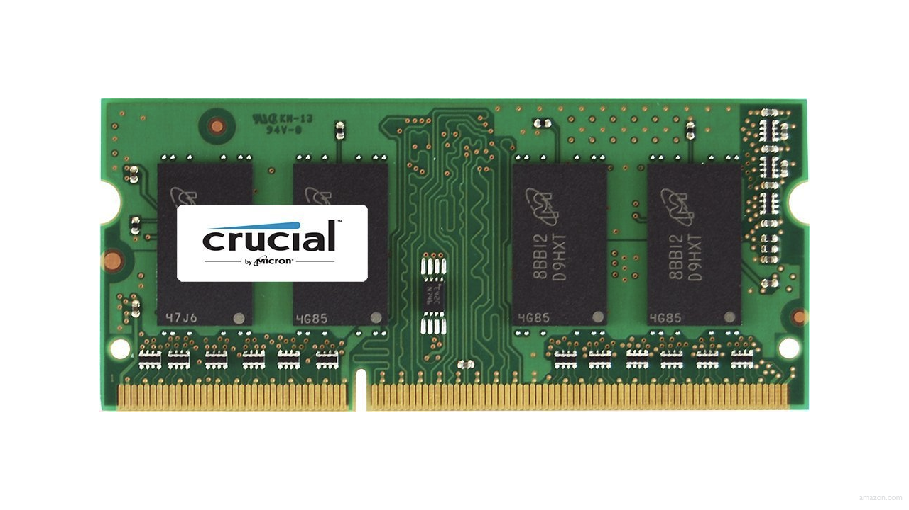

Slide 4
0000

Slide 5
0001

Slide 6
0010

Slide 7
0011

Slide 8
0100

Slide 9
0101

Slide 10
0110

Slide 11
0111

Slide 12
1000

Slide 13
integer overflow

Slide 14
00000000000000000000000000000000

Slide 15
11111111111111111111111111111111

Slide 16
4294967295

Slide 17
2147483647

Slide 18
-2147483648

Slide 19
bool
char
double
float
int
long
string
...

Slide 20
bool
char
double
float
int
long
string
...

Slide 21
get_char
get_double
get_float
get_int
get_long
get_string
...

Slide 22
get_char
get_double
get_float
get_int
get_long
get_string
...

Slide 23
%c
%f
%i
%li
%s

Slide 24
%c
%f
%i
%li
%s

Slide 25
9223372036854775807

Slide 26
truncation

Slide 27
bool
char
double
float
int
long
string
...

Slide 28
bool
char
double
float
int
long
string
...

Slide 29
get_char
get_double
get_float
get_int
get_long
get_string
...

Slide 30
%c
%f
%i
%li
%s

Slide 31
type casting

Slide 32
floating-point imprecision

Slide 33
1999

Slide 34
1999

Slide 35
1900

Slide 36
19 January 2038

Slide 37
13 December 1901

Slide 38
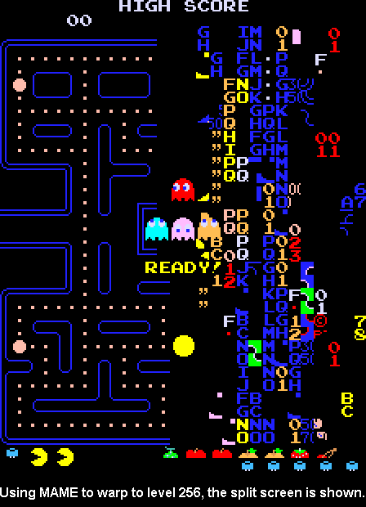

Slide 39
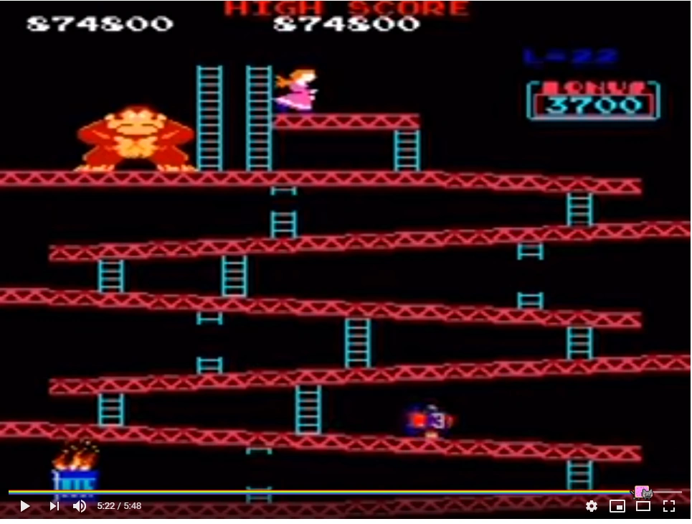

Slide 40
10 × (level + 4)

Slide 41
10 × (22 + 4)

Slide 42
260

Slide 43
4

Slide 44
